Slide 1
Random Projections & Applications To Dimensionality Reduction
Aditya Krishna Menon
(BSc. Advanced)
Supervisors:
Dr. Sanjay Chawla
Dr. Anastasios Viglas

Slide 2
High-dimensionality
Lots of data → objects/items with some attributes
  i.e. high-dimensional points
  ⇒ Matrix
Problem: number of dimensions usually quite large
  Data analysis usually sensitive to this
    e.g. Learning, clustering, searching, …
  ⇒ Analysis can become very expensive
The ‘curse of dimensionality’
  Add more attributes ⇒ exponentially more time to analyze data

Slide 3
Solution?
Reduce dimensions, but keep structure
  i.e. map original data → lower dimensional space
  Aim: do not distort original too much
  ‘Dimensionality reduction’
Easier to solve problems in new space
  Not much distortion ⇒ can relate solution to original space

Slide 4
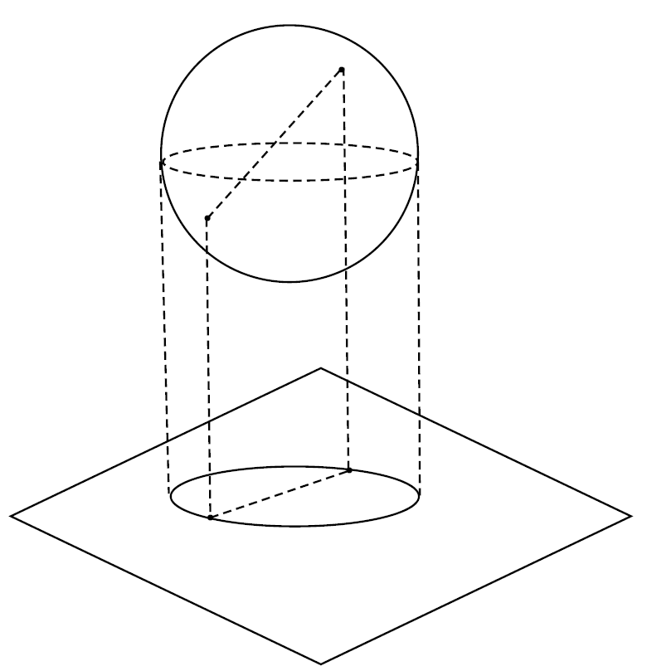
Random projections
Recent approach: random projections
Idea: project data onto random lower dimensional space
  Key: most distances
  (approx.) preserved
  Matrix multiplication

Slide 5
Illustration
Original n points in
d dimensions
New n points in
k dimensions
A.R
A
E
n x d
n x k
R is some ‘special’ random matrix
e.g. Gaussian
Guarantee: With high probability, distances
between points in E will be very close to
distances between points in A
[Johnson and Lindenstrauss]

Slide 6
Aims of my project
Can we solve data-streaming problems efficiently, and accurately, using projections?
Can we improve existing theory on ‘interesting’ properties random projections?
  Preservation of dot-products
  Guarantees on the reduced dimension

Slide 7
My contributions
Application of projections to data streaming
Novel result on preservation of dot-product
Theoretical results on lowest dimension bounds

Slide 8
I: Streaming scenario
Scenario: have a series of high-dimensional streams, updated asynchronously
  i.e. Arbitrarily updated
Want to query on distance / dot-product between streams
  e.g. To cluster the streams at fixed point in time
Problem: might be infeasible to instantiate the data
  Or might be too expensive to work with high-dimensions
Usual approach is to keep a sketch
  Small space
  Fast, accurate queries
Aim: can we use projections to maintain a sketch?
  Comparison to existing sketches?

Slide 9
My work on streams
Showed we can efficiently use projections to keep sketch
  Can quickly make incremental updates to sketch
    As if you did a projection each time!
  Guarantee: preserves Euclidean distances among streams
Generalization of [Indyk]
  Related to a special case of a random projection
Comparison
  As accurate than [Indyk]
  Faster than [Indyk]
    2/3rds sparse matrix [Achlioptas]

Slide 10
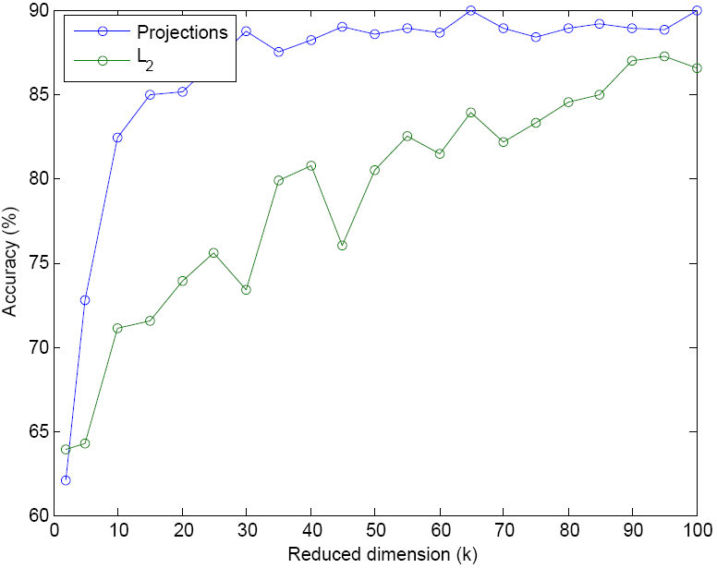
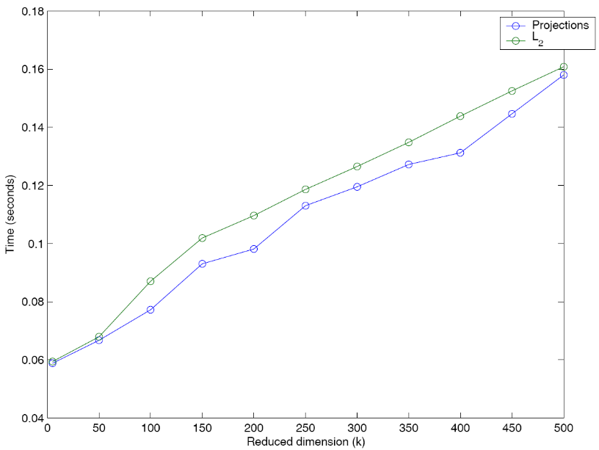
Experiments
Use projections to allow k-means clustering of high-dimensional (d = 10⁴) streams
Results
  At least as accurate than [Indyk]
  Marginally quicker

Slide 11
II: Dot-product
Dot-product is quite a useful quantity
  e.g. For cosine similarity
On average, projections preserve dot-products
  But typically large variance
  Not an easy problem
    “Inner product estimation is a difficult problem in the communication complexity setting captured by the small space constraint of the data stream model” [Muthukrishnan]
Question: can we derive bounds on the error?

Slide 12
My work on dot-products
Result: derived new bound on error incurred in dot-product after random projection
  High-probability upper bound on the error
  Complements existing work on dot-product preservation
    My bound based on distance error and lengths of vectors
    Existing results based on reduced dimension and lengths of vectors

Slide 13
III: Lowest dimension bounds
Projections give bounds on reduced dimension
  ‘If I want 10% error in my distances, what is the lowest dimension I can project to’?
[Achlioptas]’ bounds are most popular
  But quite conservative [Lin and Gunopulos]
Aim: try to improve results on bounds for reduced dimension
  Look at when bound is not meaningful
  Better special cases?

Slide 14
My work on bounds
Results:
  Theorem on analysis of applicability of [Achlioptas]’ bound
    NASC conditions for it to be ‘meaningless’
      Points exponential in number of dimensions
  Stronger result for data from Gaussian distribution
    Error restriction

Slide 15
Conclusion and future work
Random projections are an exciting new technique
  Applications to dimensionality reduction and algorithms
  Worthwhile studying properties
My contributions
  Proposed application to data-streams
  Novel result on preservation of dot-product
  Improved theoretical analysis on bounds
Future work
  [Li et. al]’s matrix and data-streams
  Lower bound analysis
  Guarantees for projections in other problems e.g. circuit fault diagnosis

Slide 16
References
[Achlioptas] Dimitris Achlioptas. 2001. Database-friendly random projections. In PODS ’01: Proceedings of the Twentieth ACM SIGMOD-SIGACT-SIGART Symposium on Principles of Database Systems, pages 274–281, New York, NY, USA. ACM Press.
[Indyk] Piotr Indyk. 2006. Stable distributions, pseudorandom generators, embeddings, and data stream computation. J. ACM, 53(3):307–323.
[Johnson and Lindenstrauss] W.B. Johnson and J. Lindenstrauss. 1984. Extensions of Lipschitz mappings into a Hilbert space. In Conference in Modern Analysis and Probability, pages 189–206, Providence, RI, USA. American Mathematical Society

Slide 17
References
[Li et al.] Ping Li, Trevor J. Hastie, and Kenneth W. Church. 2006. Very sparse random projections. In KDD ’06: Proceedings of the 12th ACM SIGKDD international conference on Knowledge discovery and data mining, pages 287–296, New York, NY, USA. ACM Press.
[Lin and Gunopulos] Jessica Lin and Dimitrios Gunopulos. 2003. Dimensionality reduction by random projection and latent semantic indexing. Unpublished. In Proceedings Of The Text Mining Workshop at the 3rd International SIAM Conference On Data Mining.
[Muthukrishnan] Data Streams: Algorithms And Applications. Now Publishers, 2005.

